Slide 1
F4E-2008-GRT-014 (ES-AC)
NUDATA_Files / Task 6
JEFF/EFF Meeting, OECD/NEA-DB, 25-27.11.2009
EFFDOC-1081
Improvement of (the) parameters for nuclear model calculations suitable for neutron activation data
  Vlad Avrigeanu, Marilena Avrigeanu, Faustin L. Roman
  “Horia Hulubei” National Institute for Physics & Nuclear Engineering, Bucharest, Romania
  http://tandem.nipne.ro/~vavrig/, http://fp6.cordis.lu/fp6/partners/RCN 49105
Extension of α-particle elastic-scattering analysis to A≥132 @ E<50 MeV
(M. Avrigeanu et al., 12th Int. Conf. on Nuclear Reaction Mechanisms, Varenna, 15-19 June 2009)
Analysis of a-particle induced reactions on 113,115In @ E< 25 MeV
(M. Avrigeanu and V. Avrigeanu, submitted to PRC, 2009-07-09/08-05; 2009-09-11 with Editors)
Analysis of (a,γ) reaction on 144Sm @ E< 14 MeV
(V. Avrigeanu et al., 2nd Int. Workshop on Nuclear Reactions and Related Topics, 5-8 Oct. 2009, Bordeaux)
RIPL-3 Utility code for calculating ROP parameter values
(M. Avrigeanu, sent to R. Capote, 2009-11-11 )
Vlad Avrigeanu
Notes:
Vlad Avrigeanu
4th Association EURATOM-MEdC Days Meeting, Ramnicu Valcea, 01-02.10. 2007

Slide 2
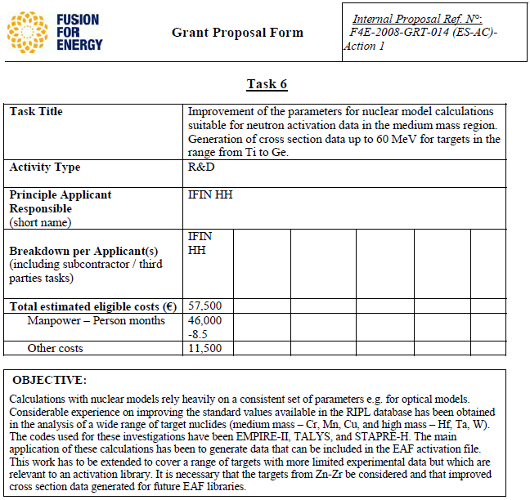
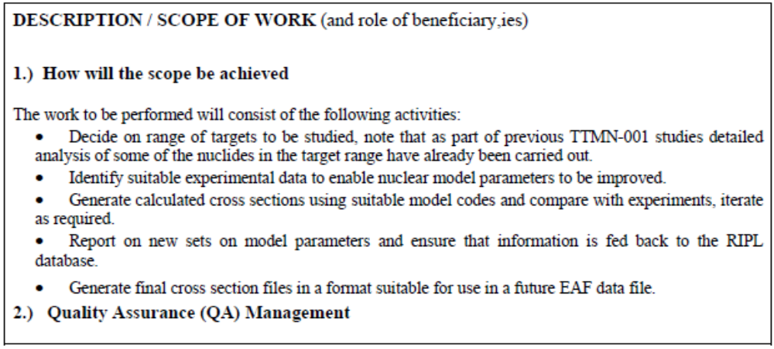
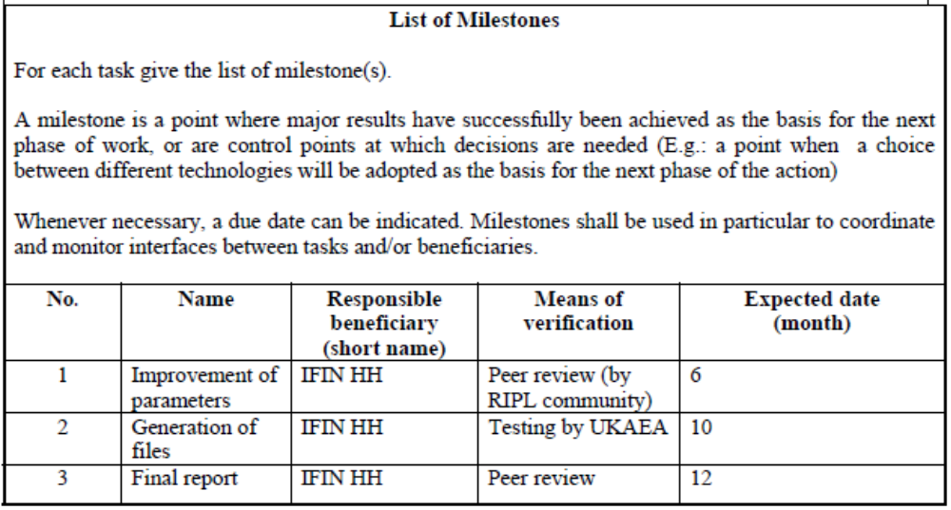
1. F4E-2008-GRT-014 (ES-AC) NUDATA_Files / Task 6

Slide 3
Nuclear data (ND) consistent model calculations
[ E.D. Arthur – P.G. Young, LANL, ’80 ]
YES
[ IAEA/NDS RCs (12), Bucharest, 1982-2005 ]
unitary use of common model parameters for different mechanisms
use of consistent sets of input parameters - determined by analyses of various independent experimental data
unitary account of whole body of related experimental data for isotope chains and neighboring elements
[ activation & particle-emission spectra ]
[ enlarged incident-energy range ]
NO
re-normalization or free parameters (widely-used within ND libraries)
Vlad Avrigeanu

Slide 4
Nuclear Model Calculations
OPTICAL MODEL : prime tool for all cross section calculations
  Phenomenological OMP (global parameter sets): still extensively used
  Microscopic OPs: reduced uncertainties (e.g., OM ambiguities)
Pure elastic scattering OP analysis
SCAT2 [O. Bersillon]
- phenomenological OP
+ semi-microscopic (DF) OP
(local version)
Phys. Rev. C62 (2000) 017001
Nucl. Phys. A693 (2001) 616
Eur. Phys. J. A12 (2001) 399
Int. J. of Mod. Phys. E, 11 (2002) 249
Nucl. Phys. A723 (2003) 104
Nucl. Phys. A 759 (2005) 327
Nucl. Phys. A 764 (2006) 246
Coupled Reaction Channel (CRC)
FRESCO-2003 [I.J. Thompson]
Composite system equilibration
- Geometry Dependent Hybrid (GDH) preequilibrium-emission model
  - Hauser-Feshbach (HF) statistical model
STAPRE-H95 [V. Avrigeanu, M. Avrigeanu]
(updated)
Notes:
0. Concerning the nuclear-model calculations actually involved in the nuclear data evaluations,
1. The OM is a prime tool. However, there are still extensively used – IN THE CASE OF ALPHA-PARTICLES - the phenomenological OMPs,
while it is known that the involvement of microscopical potentials would reduce really the uncertainties of the OMP parameter sets.
2. The computer codes used in order to obtain the results shown in this presentation are, first, SCAT2 for pure elastic scattering,…
3. …second, a local (NIPNE-Bucharest) code for usinf the DFM, with results …
4. …described in …
5. …a series of papers.
6. At the same tine it has been also used the CRC code FRESCO for elastic-transfer consideration.
7. Finally, some of the discussed OMP have been involved in PE+HF calculations with our local code STAPRE-H, which includes also SCAT2
for calculations of OM transmission coefficients, while the same OMP parameters are involved in the PE description in the frame of the GDH
model for description of the intranuclear transition rates.

Slide 5
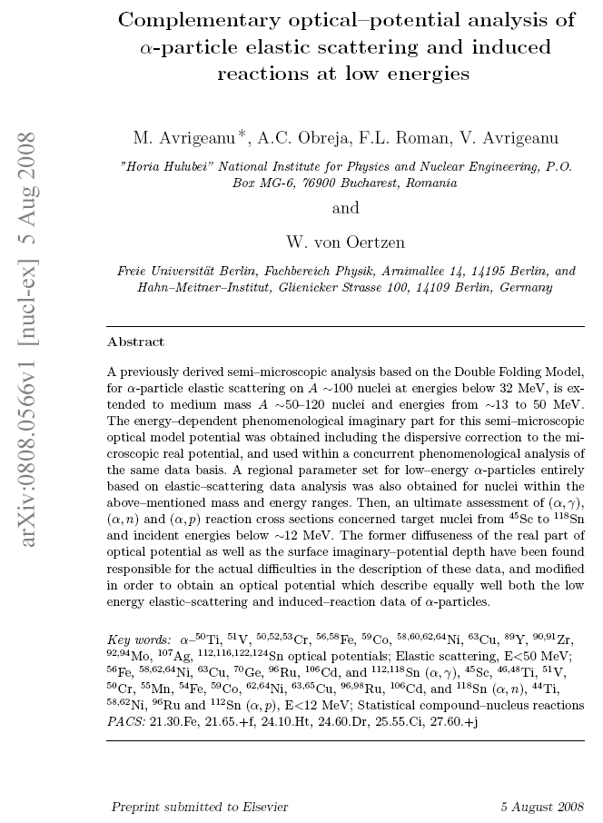
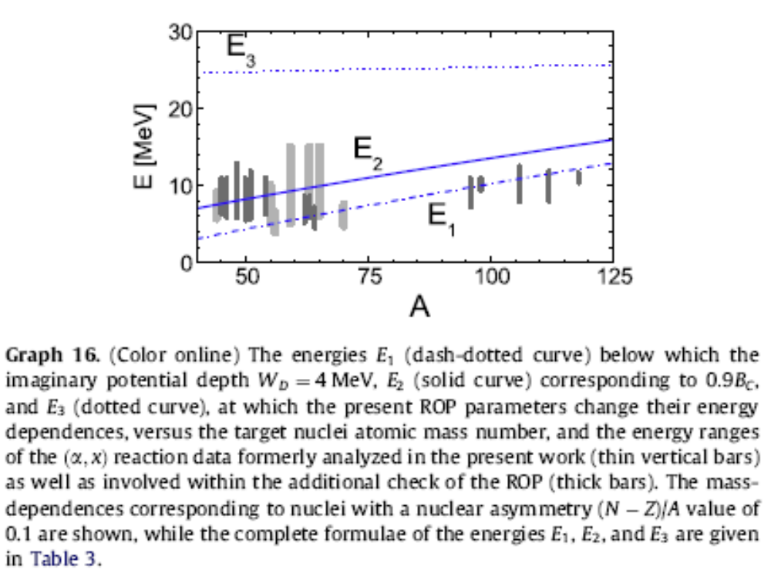
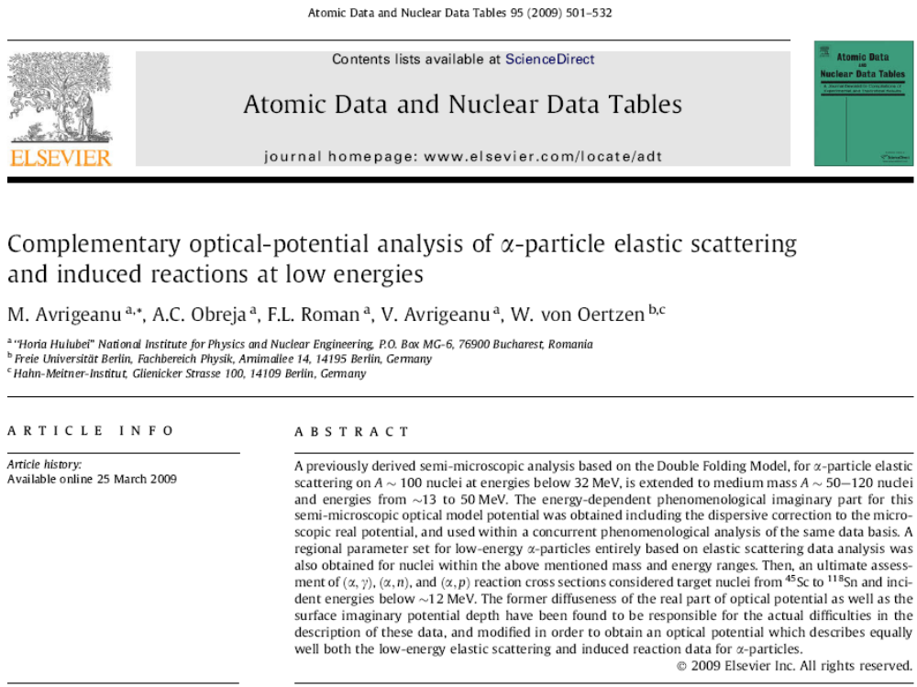
2. α-particle elastic scattering [ and induced reactions] @ E<50 MeV: ROP

Slide 6
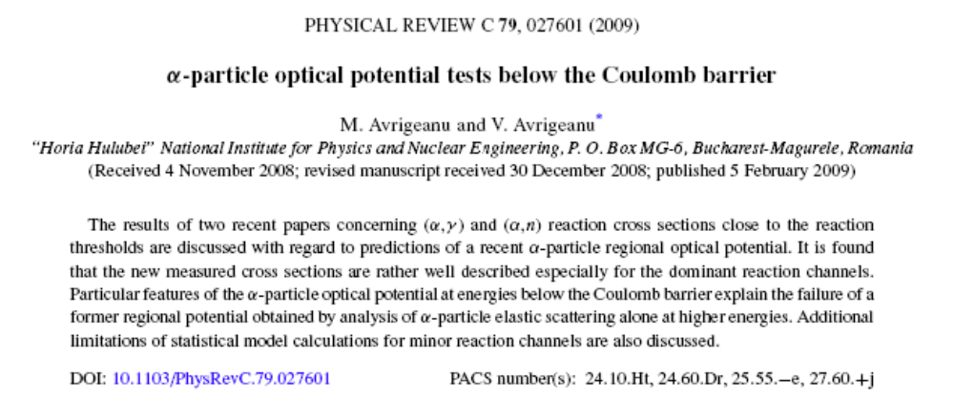
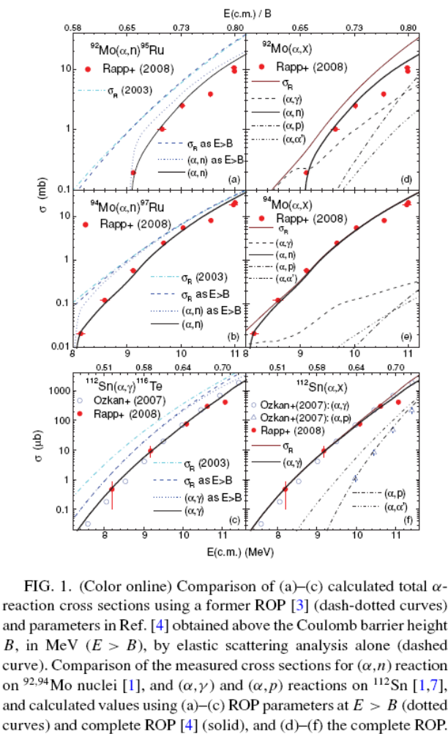
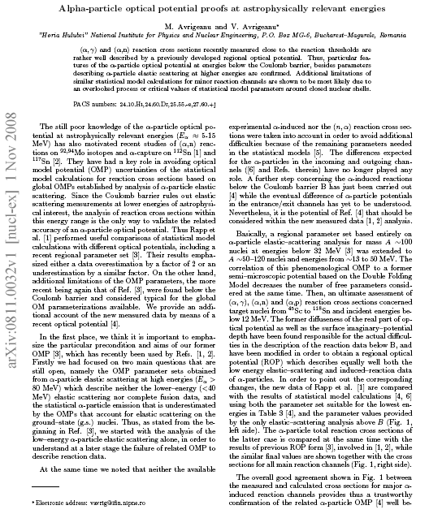
ROP-using results

Slide 7
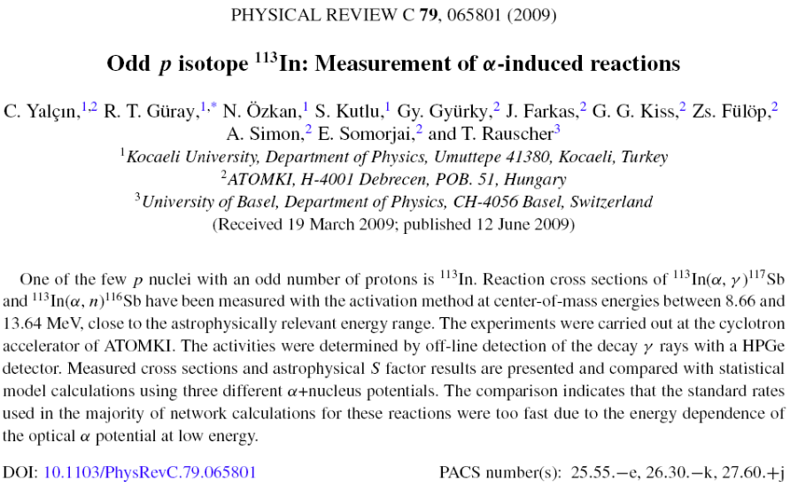
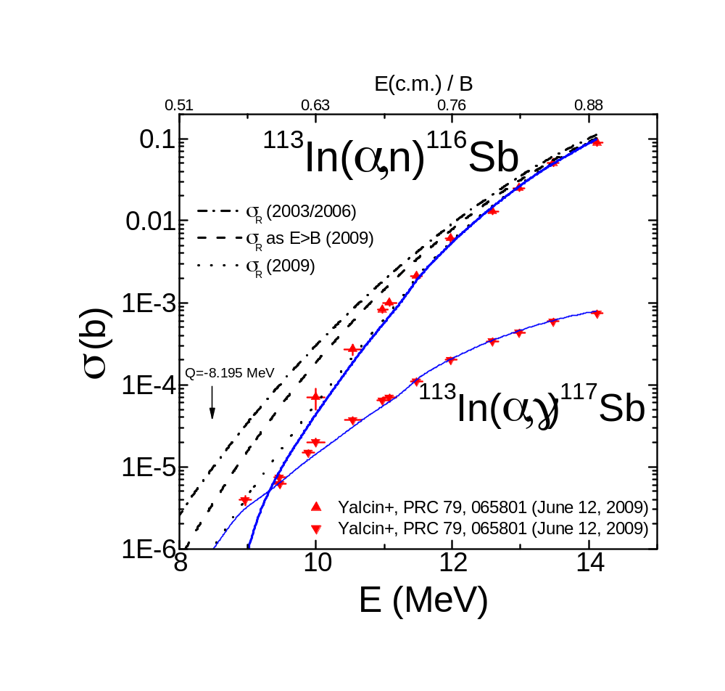
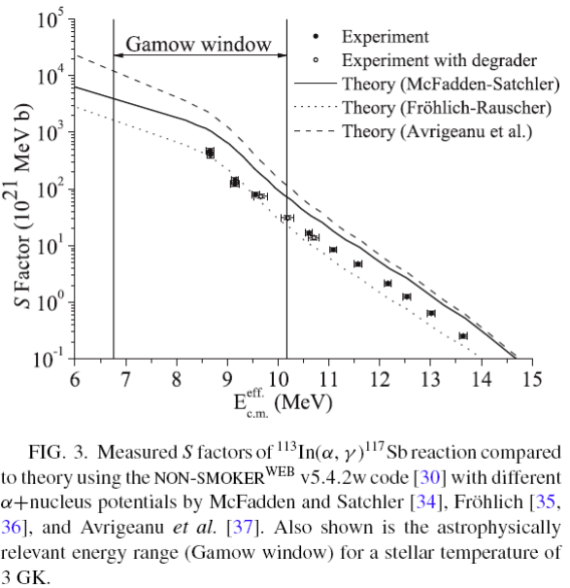
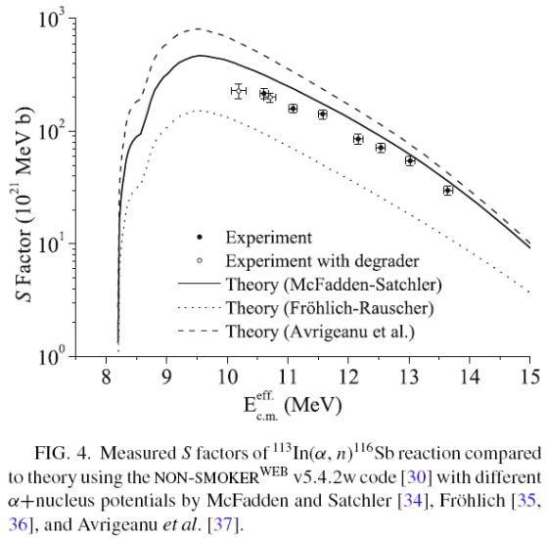
Recent questions…
[ ADNDT 95 (2009) 501; Phys.Rev. C 79 (2009) 027601 ]

Slide 8
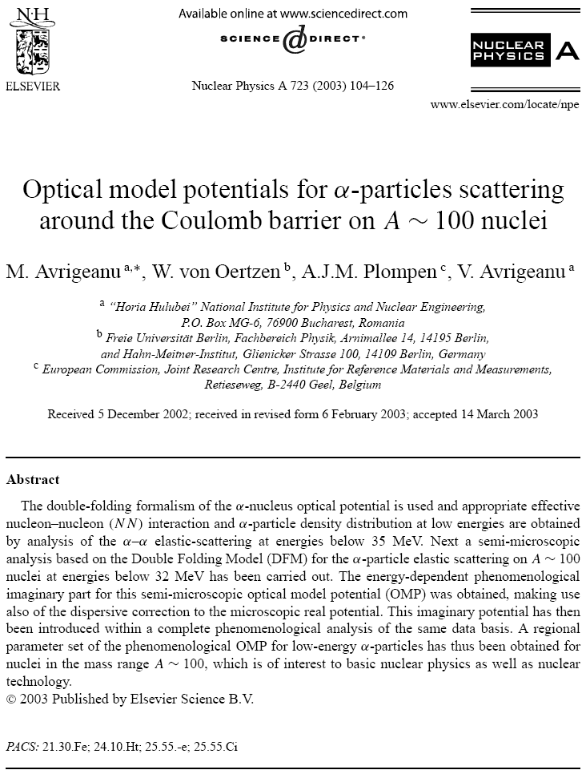

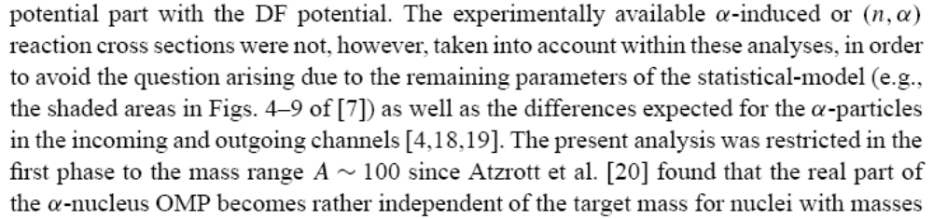
Our 2003-statements, from the beginning:

Slide 9
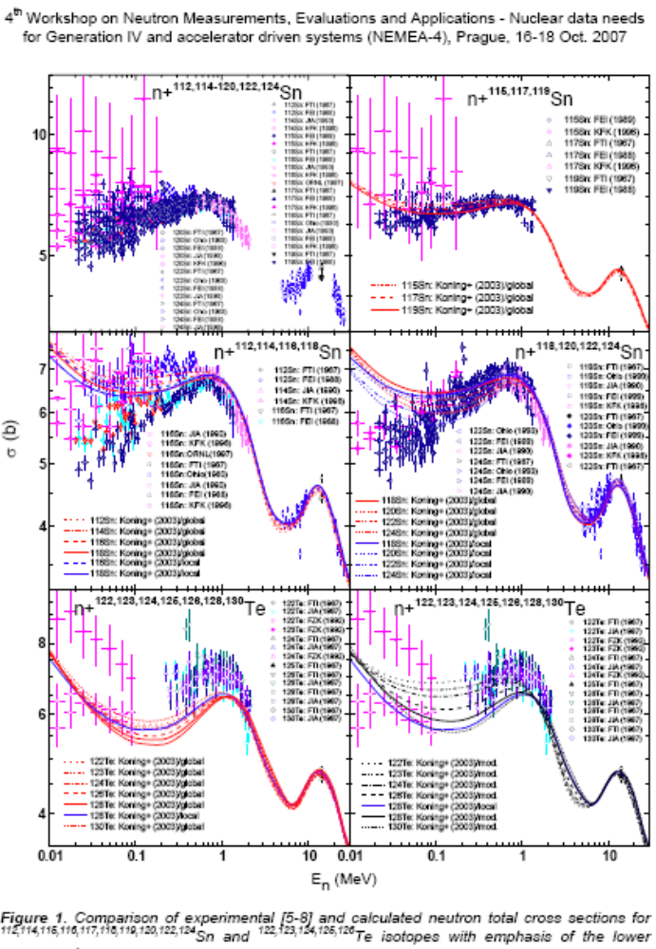
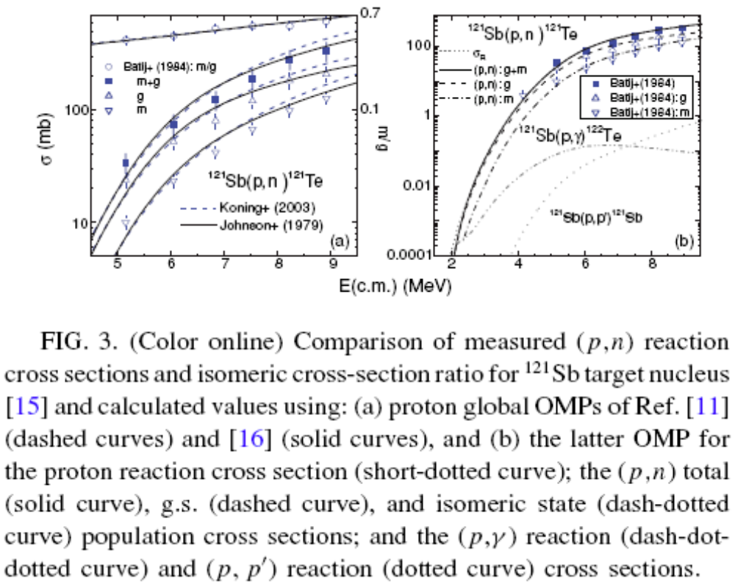
Additional check of neutron/proton OMPs
EC Report EUR 23235 EN, 2008, p. 143
www.irmm.jrc.be/html/publications/

Slide 10
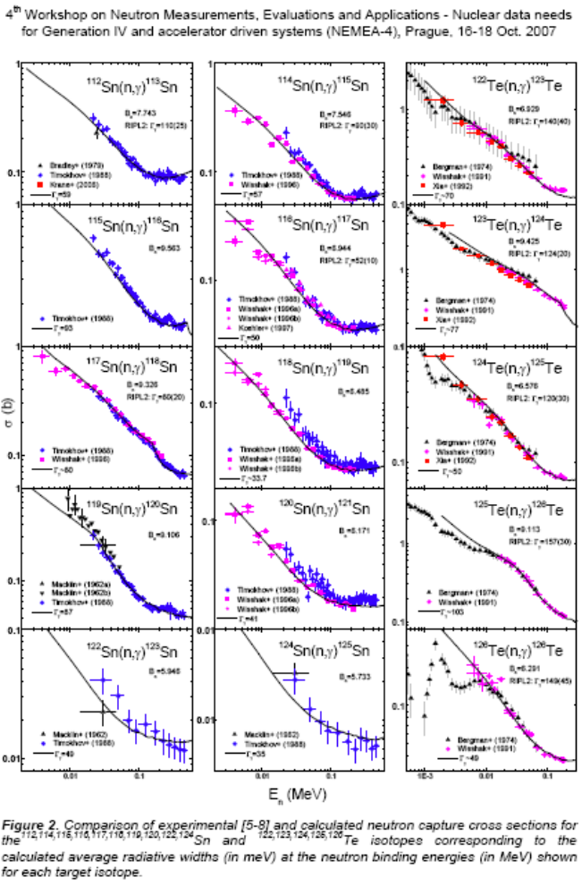
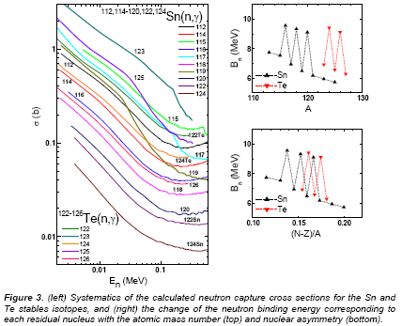
Former check of γ-ray strength functions
EC Report EUR 23235 EN, 2008, p. 143
www.irmm.jrc.be/html/publications/

Slide 11
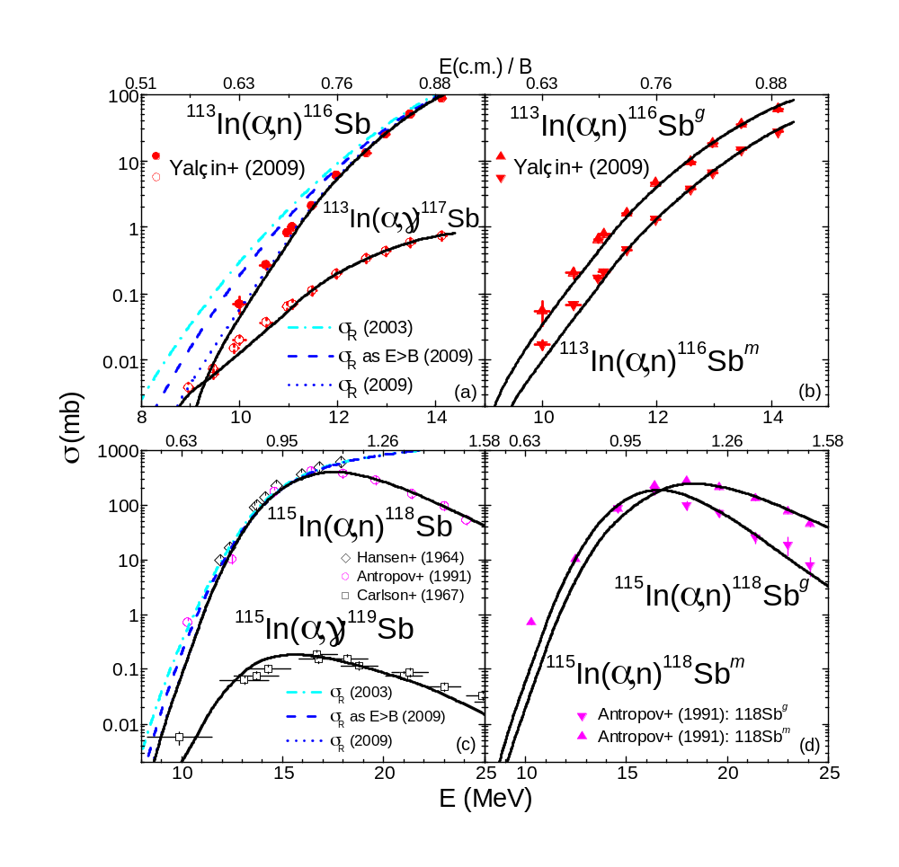
More ROP-using results for… (1/2)
… more isotopes
… enlarged E-range

Slide 12
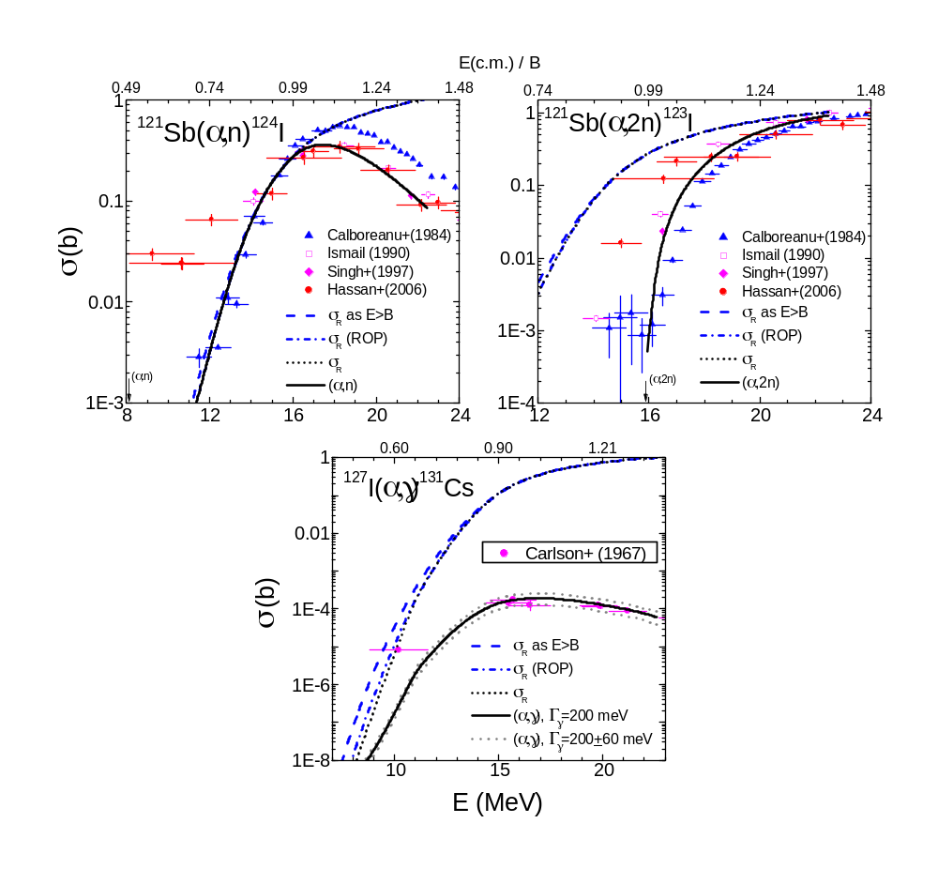
More ROP-using results for… (2/2)
… more elements
(similar A)

Slide 13
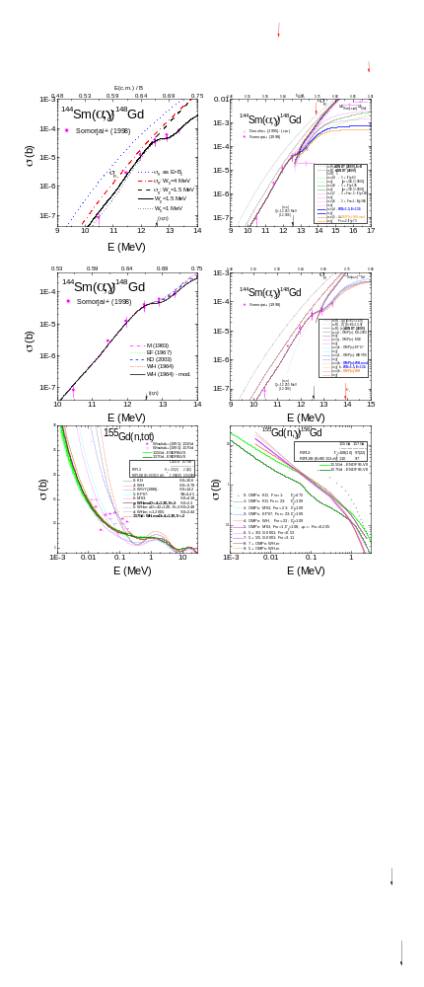
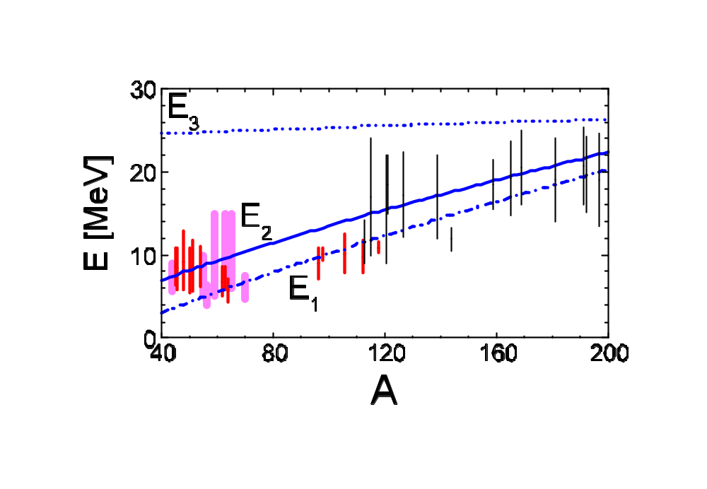
(α,γ) on ¹⁴⁴Sm – lowest-energy proof for medium to heavy nuclei
Energies E₁ below which the imaginary-potential depth W_{D}=4 MeV, E₂ ~ 0.9B_{C}, and E₃, at which ROP parameters change their energy dependences, versus the target A, and the energy ranges of the (α,x) reaction data formerly analyzed in Ref. 9 (vertical bars) as well as involved within the additional check of ROP (thick bars), and for A>120 (thin bars).
W_{D}=(1.5+0.5) MeV,
E<13.6 MeV

Slide 14
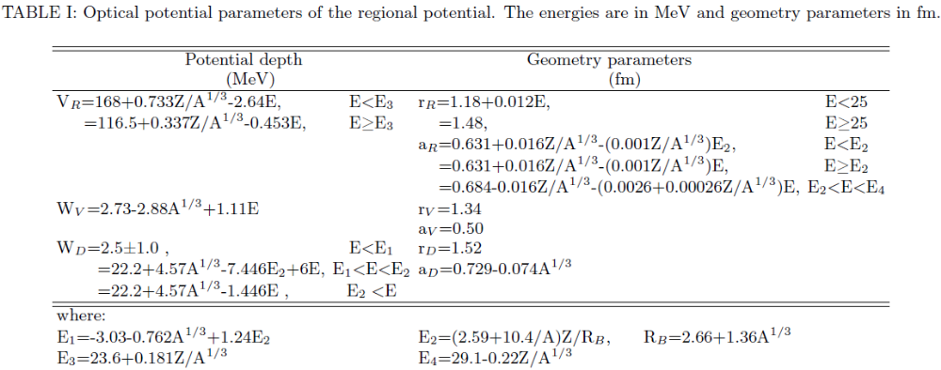
3. Extended ROP: A=40-209 (2/2)
Changes vs. A=40-120 [ADNDT 95, 501 (2009)]:
W_{D}=3.5 MeV, A<130
=1.5 MeV, A>130

Slide 15
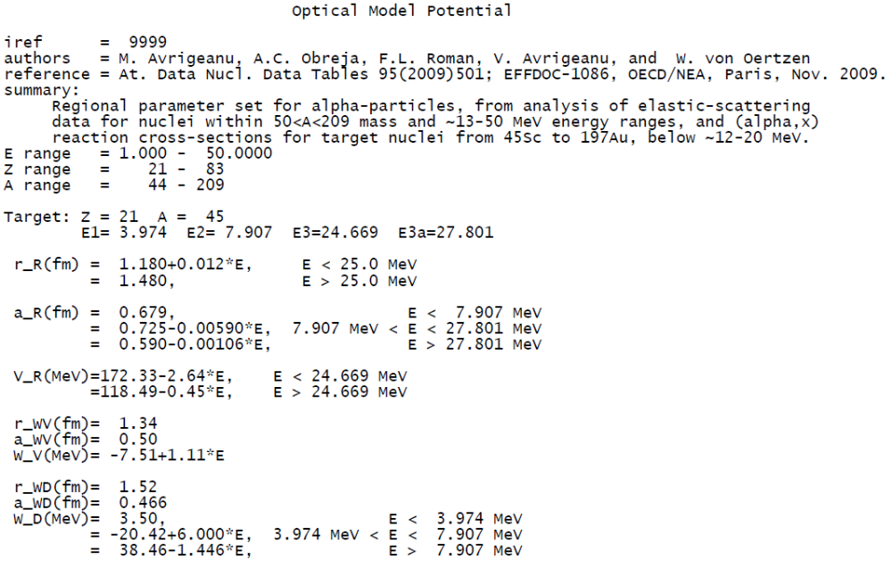
RIPL-3 Utility code for calculating ROP parameter values (1/3)
Forms f(Z,A):

Slide 16
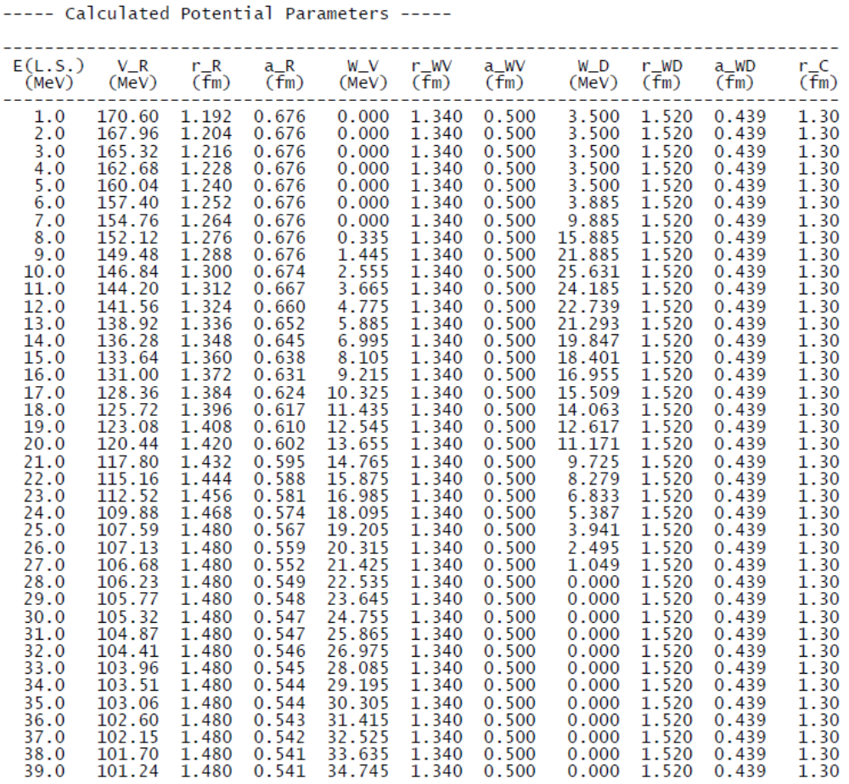
RIPL-3 Utility code for calculating ROP parameter values (2/3)
Parameter values Tables:

Slide 17
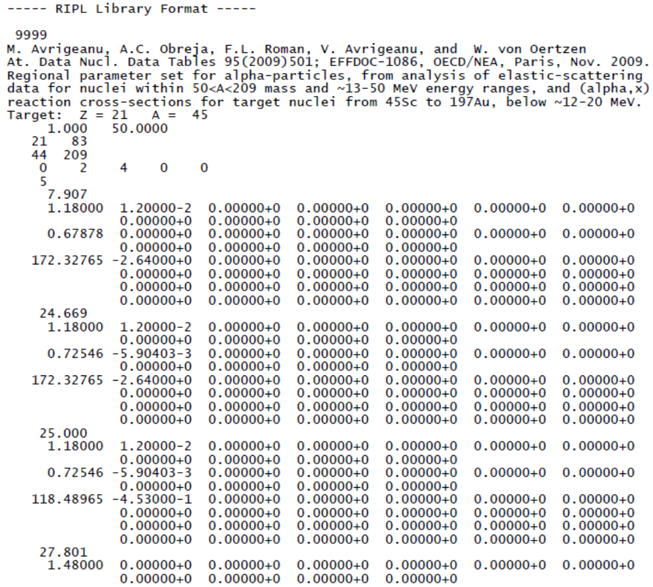
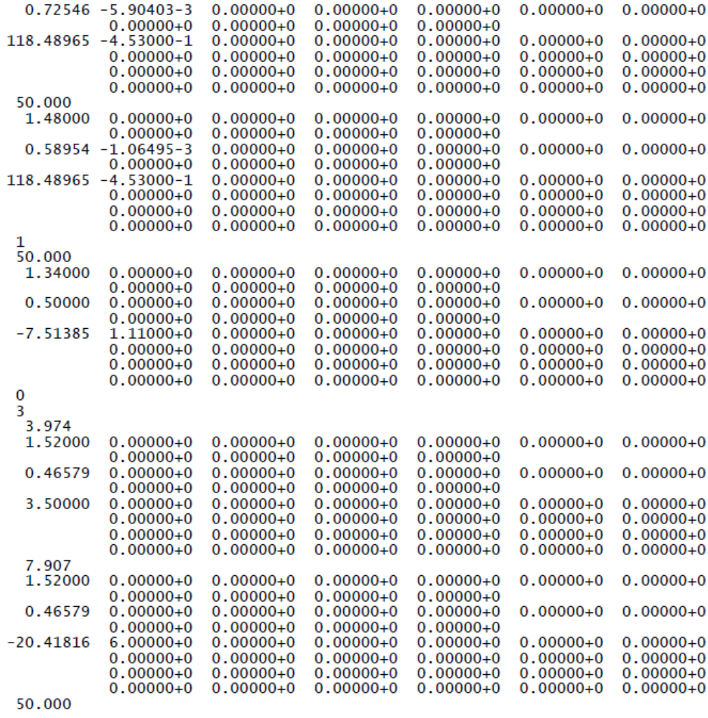
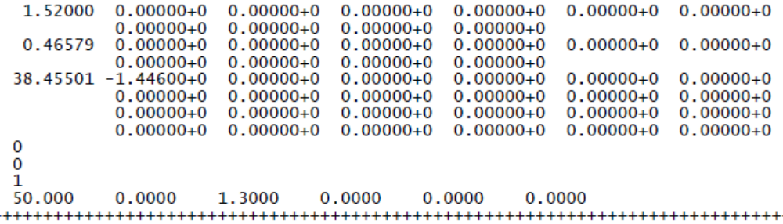
RIPL-3 Utility code for calculating ROP parameter values (3/3)
RIPL
Format:

Slide 18
Conclusions
Achievements
  ROP-2009: accurate description of (α,α) @ E<50 MeV
  (α,γ) (a,n) data for ^{113,115}In - ¹⁴⁴Sm nuclei: ROP-2009 support
Next (final?) step for α-OMP:
  α-particle emission
  Calculated (n,α) reaction cross-section enhanced accuracy
F4E-2008-GRT-014 (ES-AC) / Task 6 further work:

Slide 19
Thank you !

